Slide 1
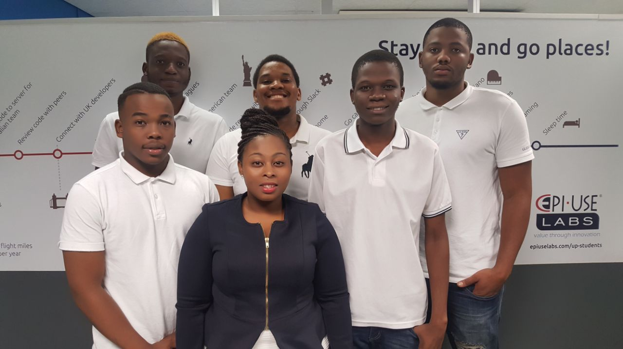
About the team:
Collaboration and synergy.
Passion and Creativity.
Enthusiasm.
Follow-through.
We believe:
“If everyone is moving forward together then success takes care of itself.”
ALPHA-TECH

Slide 2
Problem Statement:
Businesses rely on the business cards or pamphlets to attract and to keep in touch with clients; however business cards have many flaws such as:
Business Card
Getting lost
Not reusable
Not Environmentally friendly
Fixed amount
Redundancy
Information becomes out dated
ALPHA-TECH

Slide 3
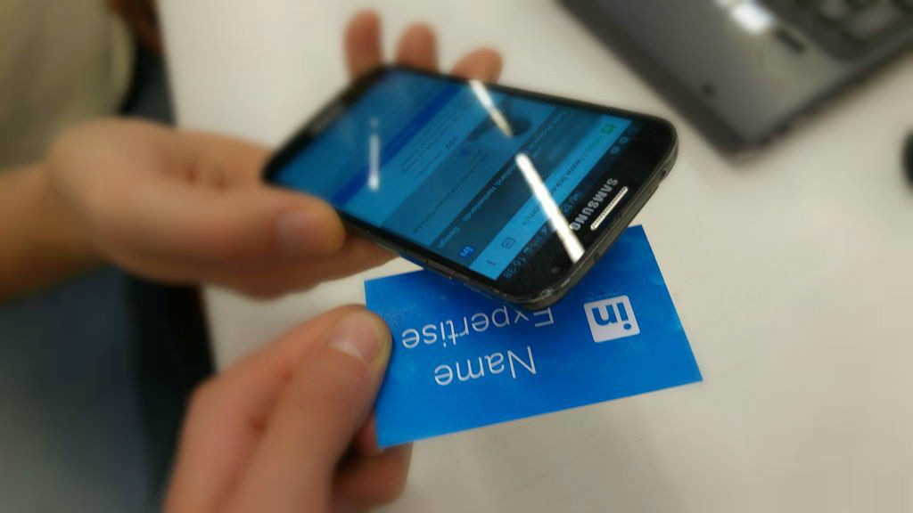
Project description
Our project is focused on building a mobile application that uses NFC to transfer information with a single tap from the business card which has NFC chip and store the information on the user’s device .
ALPHA-TECH

Slide 4
NFC business cards and Mobile devices with NFC
Simplifies the exchange of information.
More durable.
Unlimited amount of distribution.
Updating information is more efficient.
ALPHA-TECH

Slide 5
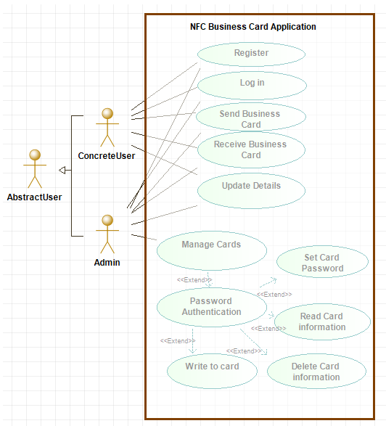
Use case Diagram
ALPHA-TECH

Slide 6
Requirements
Our application is to be used on mobile devices
System allows digital information exchange.
Our system allows effective updates of information on the business cards
It must be secure
It must be user friendly
ALPHA-TECH

Slide 7
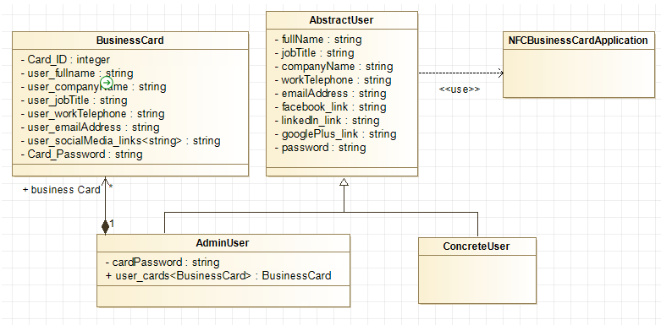
Domain Model
ALPHA-TECH

Slide 8
Design outline
ALPHA-TECH

Slide 9
Technologies to be used:
Android Studios for Mobile development.
NFC chip used for data exchange between phone and business card.
HTML, PHP and CSS for website front-end.
mySQL Database for storing user information.
ALPHA-TECH

Slide 10
Deployment Diagram
ALPHA-TECH

Slide 11
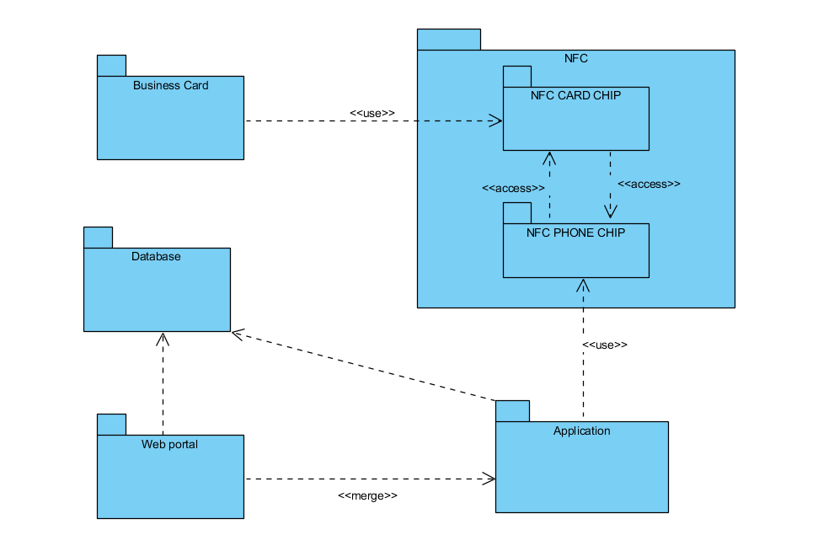
Package Diagram
ALPHA-TECH

Slide 12
References
Joep1986. 2015. Digital-Business-Card-With-NFC. [ONLINE] Available at: http://www.instructables.com/id/Digital-Business-Card-With-NFC/. [Accessed 10 March 2018].
ALPHA-TECH

